Slide 1
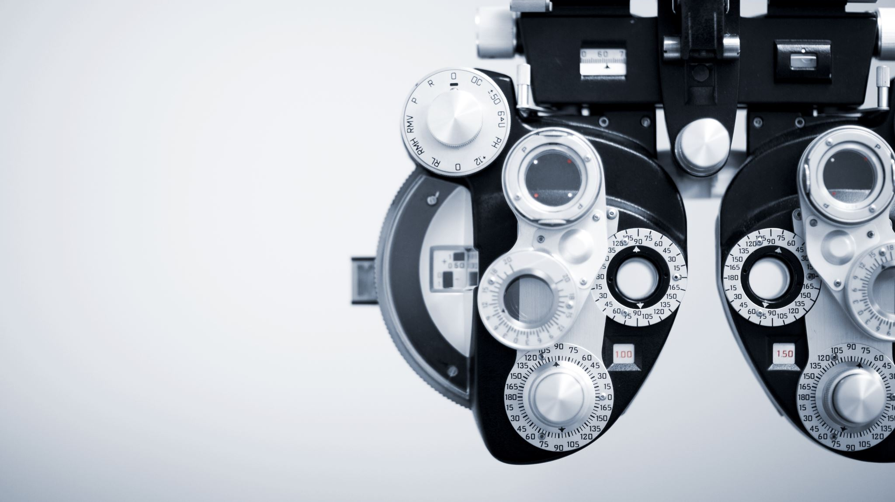
3D PRINTERS
-Roselyn Selvam

Slide 2
3D PRINTERS
What?
3D printing is a method of making 3-dimensional objects by additive means based on digital models. The process of creating these 3D objects is called "printing." The term "3D printer" refers to the device which creates these objects. 3D printers are usually stand-alone devices that can be fed digital data and output physical objects. They find use in many fields and industries, including art, design, and engineering. They are Used for rapid prototyping

Slide 3
HOW DOES 3D PRINTING WORK AND WHY USE IT
3D software
Slicing: from file to 3D Printer
3D print layer by layer
Why ?
3D printers are used for rapid prototyping because it’s fast and relatively cheap. From idea, to 3D model to holding a prototype in your hands is a matter of days instead of weeks. Iterations are easier and cheaper to make and you don’t need expensive molds or tools.
Besides rapid prototyping, 3D printing is also used for rapid manufacturing. Rapid manufacturing is a new method of manufacturing where businesses use 3D printers for short run / small batch custom manufacturing.

Slide 4
TYPES OF 3D PRINTING
Direct Metal Laster Sintering (DMLS)
Eectron Beam Melting (EBM)
Digital Light Process (DLP)
Selective laser melting
Polyjet printing
Fused deposition modelling (FDM)
Stereolithography (SLA)
Selective Laser Sintering (SLS)
Multi-Jet Fusion (MJF)
Selective laser melting

Slide 5
TYPE OF MATERIAL USED
Plastic and metal materials are used
Plastic :
there are 2 types of plastics mainly used a) thermoplastics b) thermosetting plastics
3D printers that use thermoplastics are FDM and SLS 3D printing
3D printers that use thermosetting plastics are SLA 3D printing
Metals :
3D Printers that use metals are Metal FDM, SLM and DMLS 3D printing

